Slide 1

Capstone Project 2
HEART DISEASE DETECTION
Team Members
T120100319: Keerthanapriya S
T120100328: Rida Afnar
T120100329: Rukhaiya Raheem
T120100332: Sinchana H S
T120100336: Nailah Fathima
T120100337: Sameen Mehnaz Fathima

Slide 2
Table of Contents
Problem Statement
Overview of the Project
Data generation & Loading
Data Exploration & Understanding
Exploratory Data Analysis
Data Preprocessing & Feature Engineering
Model Building & Training
Model Evaluation & Performance Analysis
Stream API Deployment
Docker Deployment
Conclusion

Slide 3
Problem Statement
The project aims to predict whether a person has heart disease based on clinical test data such as blood pressure, cholesterol, ECG results, and exercise performance.
The goal is to help healthcare professionals with early detection and decision support using machine learning.

Slide 4
Overview of the Project
Domain: Healthcare
Type: Classification Problem
Input: Clinical test results (e.g., blood pressure, cholesterol, ECG, etc.)
Output: Presence(1) or absence(0) of heart disease
Approach: Compare multiple ML models to identify the best performing one for medical prediction.
Data Collection
Preprocessing
Model Training
Evaluation
Deployment

Slide 5
Data generation & Loading
The dataset contains 14 features, including age, gender, cholesterol, resting blood pressure, maximum heart rate, chest pain type, and ECG results.
The target variable is heart_disease (0 = No disease, 1 = Disease).
The data was loaded using Pandas and checked for missing values,
data types, and distributions.
 | age | sex | chest_pain_type | resting_blood_pressure | cholesterol | fasting blood_ sugar | resting Ecg | max_ heat_ rate | exercise_ induced_ angina | st_ depression | st_slope | num_ major_ vessels | thalassemia | heart_ disease
0 | 58 | 1 | 1 | 134 | 246 | 0 | 0 | 155 | 0 | 0.4 | 1 | 1 | 2 | 1
1 | 52 | 0 | 2 | 112 | 245 | 0 | 0 | 143 | 1 | 0.1 | 0 | 0 | 3 | 1
2 | 59 | 0 | 2 | 126 | 196 | 0 | 0 | 162 | 1 | 1.1 | 1 | 0 | 1 | 1
3 | 67 | 1 | 1 | 165 | 201 | 0 | 0 | 180 | 0 | 0.4 | 2 | 0 | 2 | 0
4 | 51 | 1 | 0 | 146 | 174 | 1 | 1 | 133 | 1 | 0.9 | 1 | 1 | 2 | 1

Slide 6
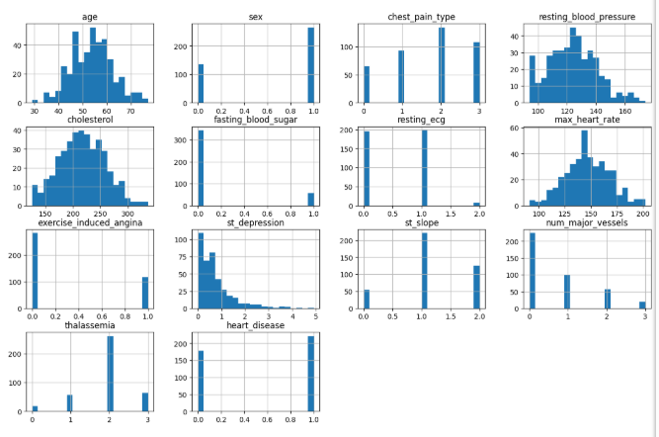
Data Exploration & Understanding
The dataset was explored to understand the statistical properties and underlying relationships between features.
Important features affecting heart disease were found using a correlation matrix.

Slide 7
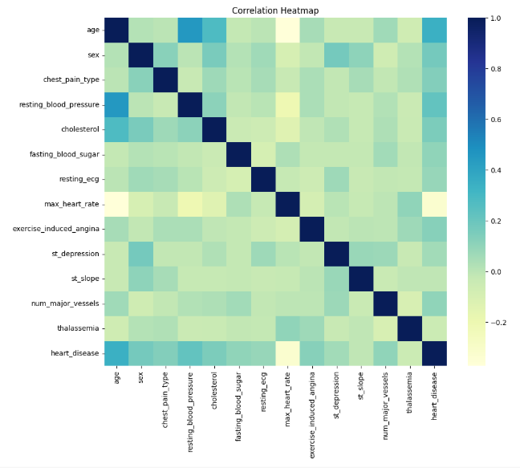
Exploratory Data Analysis
Comprehensive exploratory data analysis was carried out to visualize feature distributions, correlations, and outliers.
Graphs like heatmaps, histograms, and boxplots were made to explore the data.
EDA helped to find useful patterns and trends in the dataset.

Slide 8
Data Preprocessing & Feature Engineering
Categorical data was encoded into numbers.
All numerical features were scaled using StandardScaler for better model performance.
The dataset was split into 80% training and 20% testing sets.

Slide 9
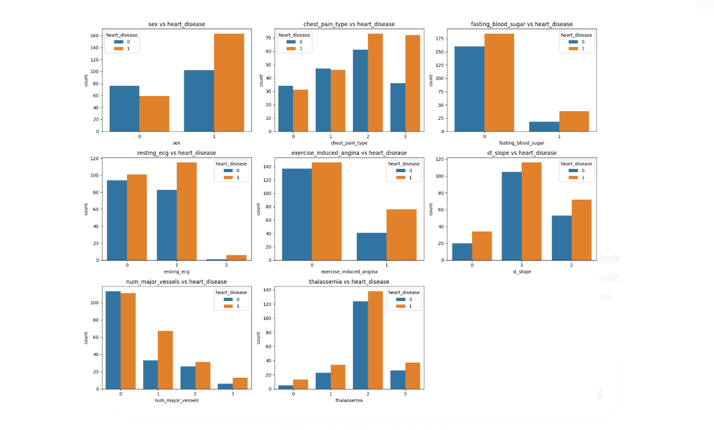

Slide 10
Model Building & Training
Four machine learning models were trained and compared:
Decision Tree Classifier
Random Forest Classifier
Logistic Regression
Support Vector Machine (SVM)
Each model was tested using 5-fold cross-validation to make sure results were consistent and not biased.

Slide 11
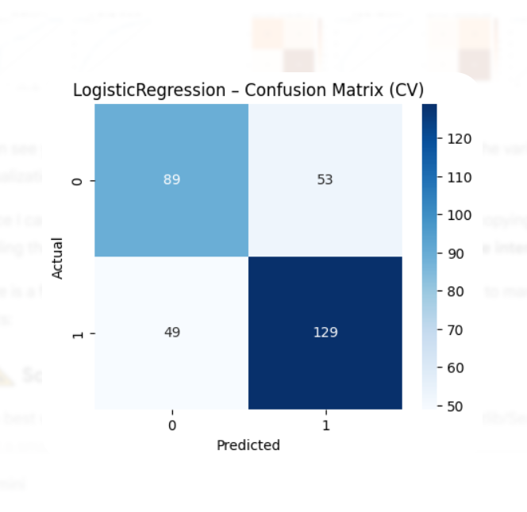
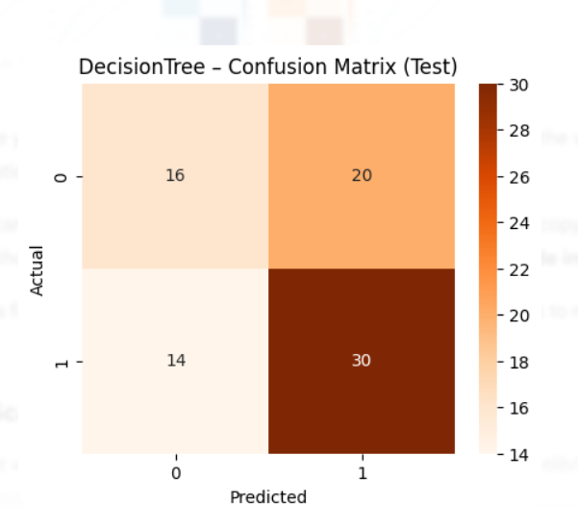
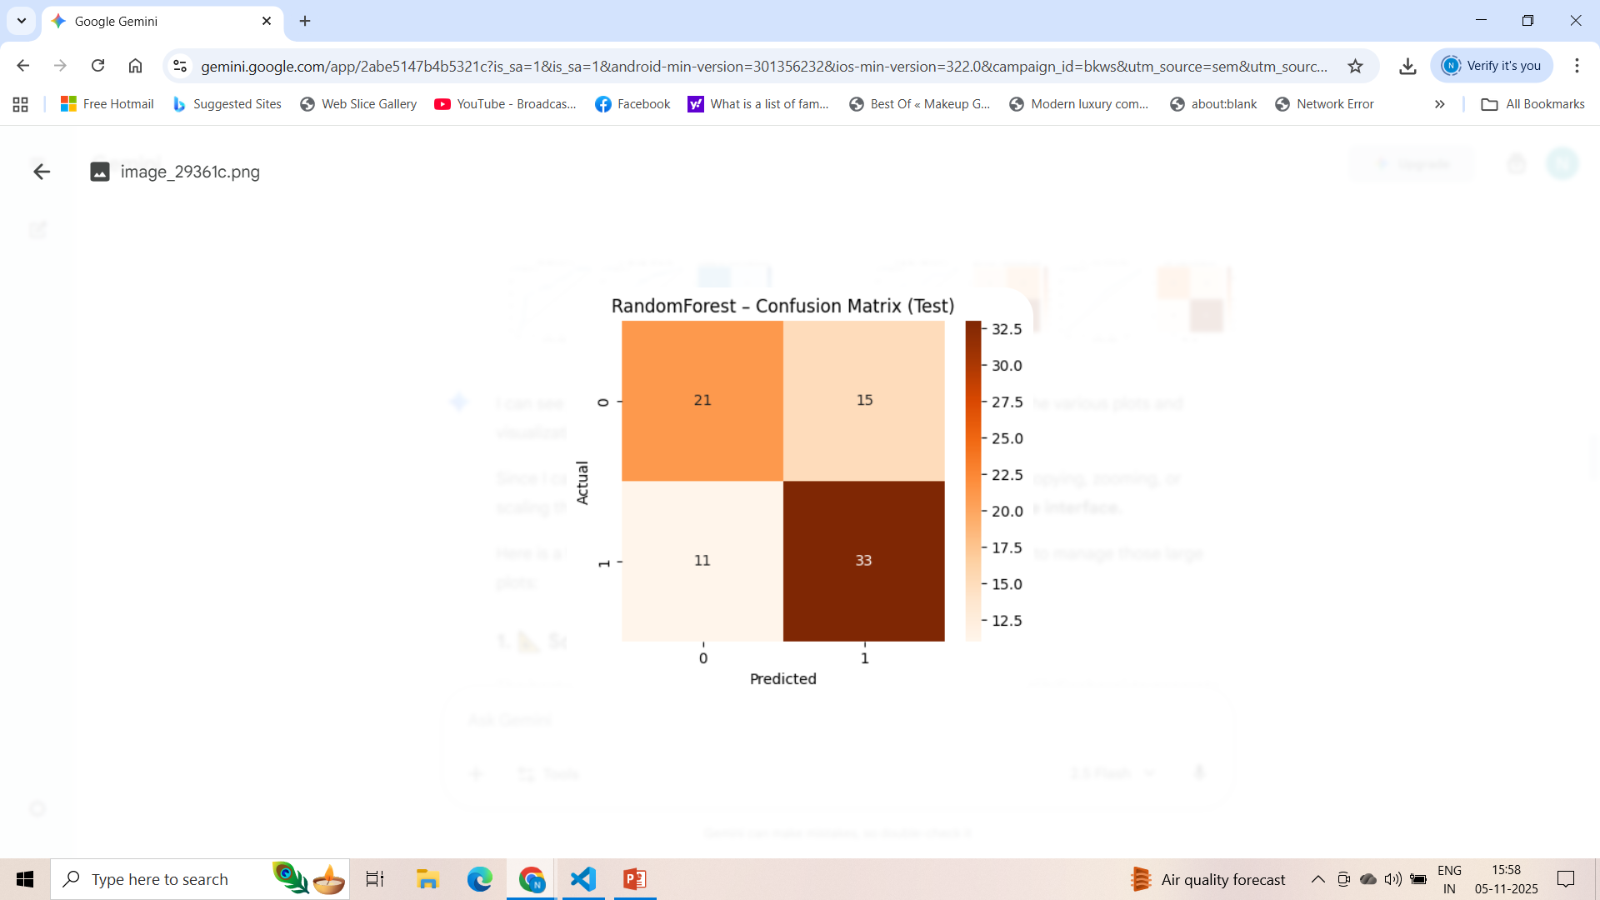
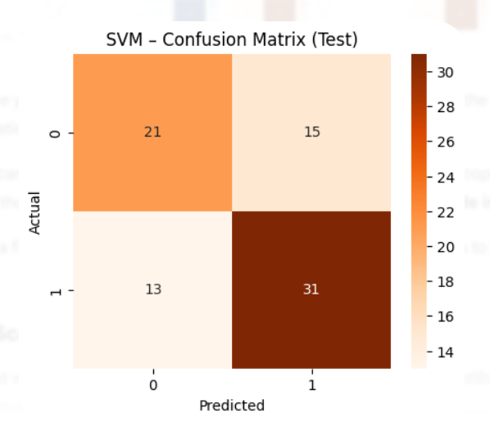
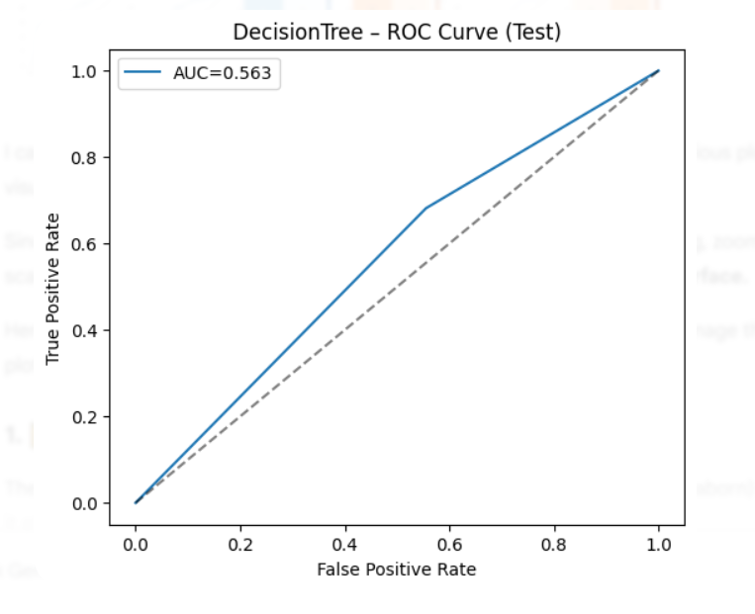
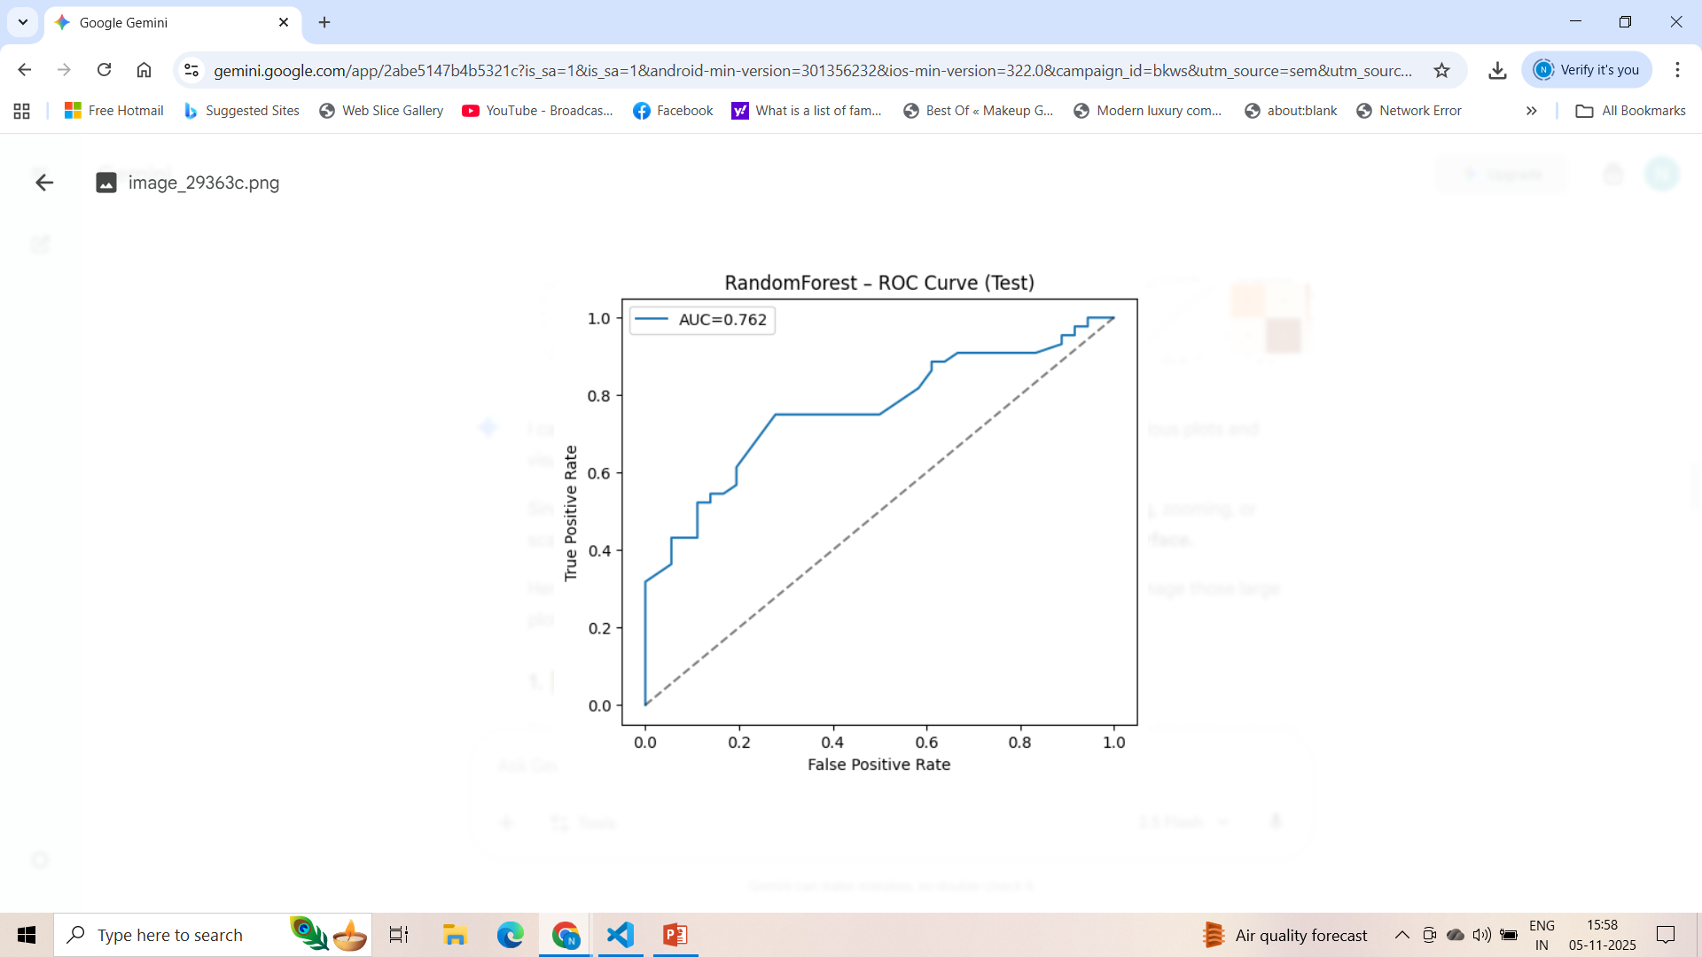
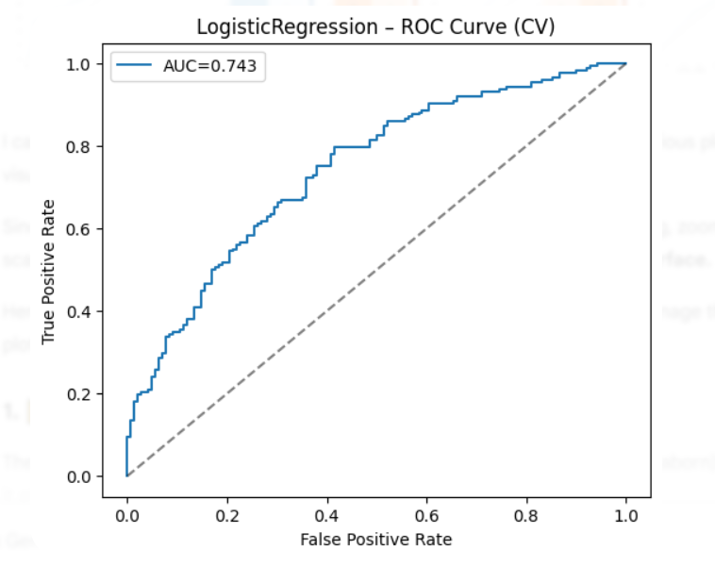
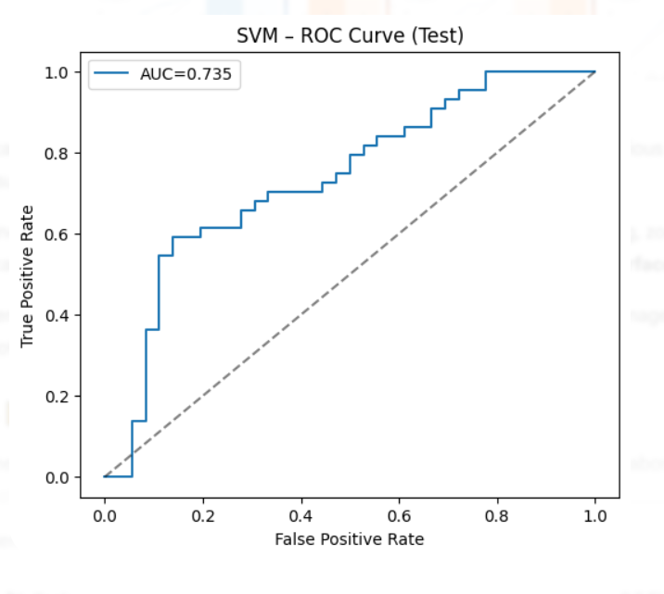

Slide 12
Model Evaluation & Performance Analysis
The models were tested using metrics such as Accuracy, Precision, Recall, F1-Score, and ROC-AUC.
Among all models, the Random Forest Classifier performed the best with high accuracy and ROC-AUC above 0.85.
Confusion matrices and ROC curves helped visualize how well each model classified patients.

Slide 14
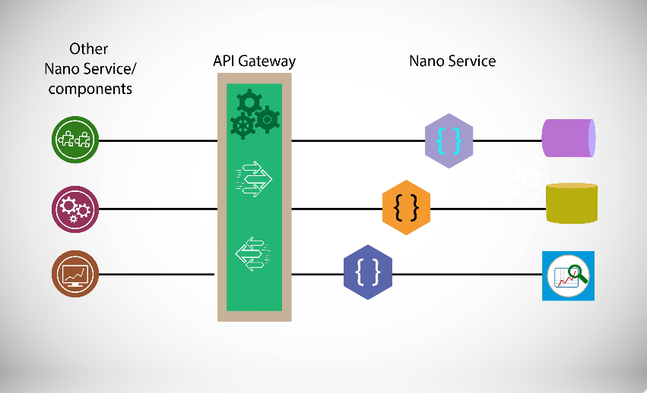
Stream API & Docker Deployment
Stream API deployment means making your trained machine learning model accessible through a web interface so others can send data and get predictions.

Slide 15
Docker Deployment
Docker deployment makes your application portable and easy to run on any computer or server.
Benefits:
Works the same on all systems.
Easy to scale and manage.
Simplifies deployment for production use.

Slide 16
Conclusion
A simple and accurate machine learning system was created to predict heart disease.
The Random Forest model gave the best and most stable results.
This project shows how AI can help in early diagnosis and risk prediction for better healthcare.
In the future, this model can be linked to hospital systems and deployed on cloud platforms.

Slide 17
Any Queries ???

